Slide 1
America’s Health Rankings ® Senior Report: A Call to Action for Individuals and Their Communities
Preview for Public Information Officers
May 7, 2014
Embargoed until May 21, 2014, at 12:01 a.m. EDT

Slide 2
Introducing Today’s Speakers
Tom Eckstein, MBA
Principal, Arundel Street Consulting, Inc.
Shelly Espinosa, MPH
Director, Community Affairs, United Health Foundation

Slide 3

Today’s Agenda
Introduction
Model, Metrics and Methodology
Senior Health in the U.S.
Report Contents and State Rankings
What We Can Do
Discussion
Please note:
All data embargoed until May 21, 2014, at 12:01
AM EDT

Slide 4
Exclusive Access to Full Data
To view the data, report and sample infographics as they become available (no later than May 14), please visit:
www.arundelstreet.com/2014senior
username: AHR
password: preview
EMBARGOED until
May 21, 2014
at 12:01 a.m. EDT

Slide 5
America’s Health Rankings® Senior Report
A Comprehensive Assessment of Senior Health
2nd edition, updates the data we gathered for the 2013 inaugural report.
Offers a comprehensive analysis of senior health on a national and state-by-state basis across 34 measures of senior health.
Report seeks to promote discussion around the health of Americans 65 years and older while driving communities, governments, stakeholders and individuals to take action to improve senior health.
In compiling the report, researchers worked with a panel of leading public health scholars.
Report draws data from more than 12 government agencies and leading research organizations, including the U.S. Department of Health and Human Services, the U.S. Department of Commerce, the U.S. Department of Labor, The Dartmouth Atlas Project, the National Foundation to End Senior Hunger and the Commonwealth Fund.

Slide 6
Model, Metrics and Methodology

Slide 7
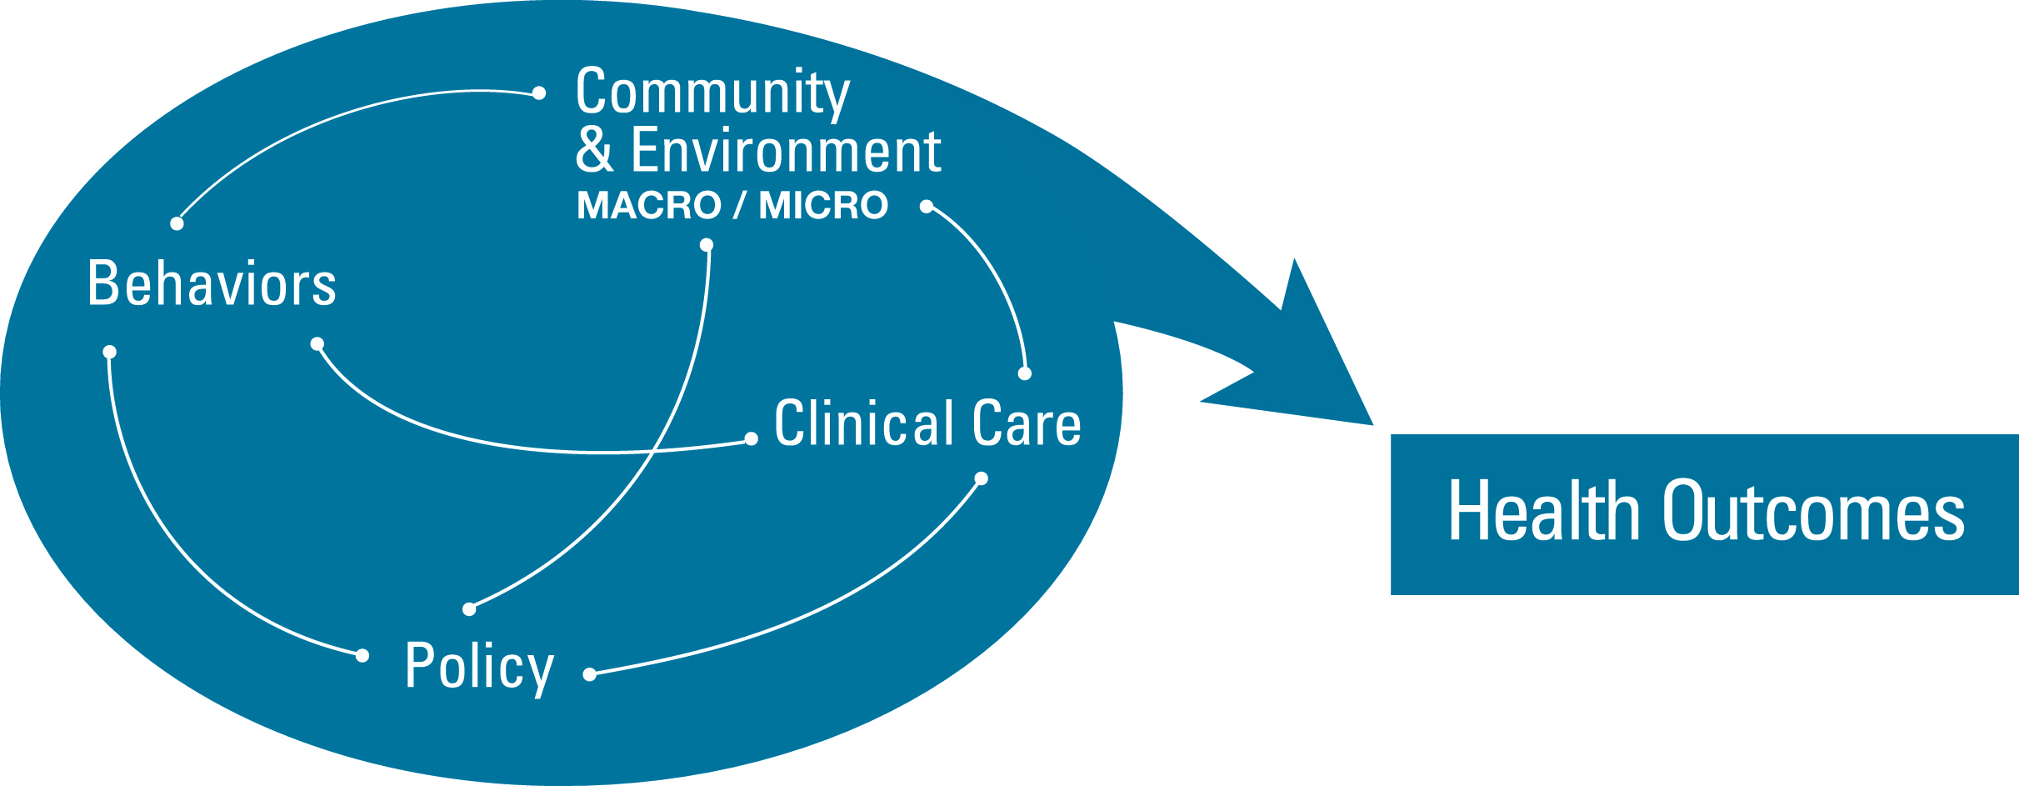
Model and Metrics
Behaviors
Smoking
Chronic Drinking
Obesity
Underweight
Physical Inactivity
Dental Visits
Pain Management
Community – Macro
Poverty
Volunteerism
Quality Nursing Homes
Community – Micro
Social Support
Food Insecurity
Community Support
Policy
Low-Care Nursing Home Residents
Prescription Drug Coverage
Geriatrician Shortfall
Clinical Care
Dedicated Health Care Provider
Recommended Hospital Care
Flu Vaccine
Health Screenings
Diabetes Management
Home Health Care
Preventable Hospitalizations
Hospital Readmissions
Hospice Care
Hospital Deaths
Outcomes
ICU Usage
Falls
Hip Fractures
Health Status
Able-Bodied
Premature Death
Teeth Extractions
Mental Health Days

Slide 8
Data Updates
Two Changes:
Highly-rated Nursing Homes → Quality Nursing Homes
Shift from number of 4- and 5-star beds per 1,000 adults aged 75+ to percentage of beds that are rated 4- or 5-stars.
Change focus of measure from capacity to quality.
Data source for Falls data (BRFSS) changed definition from self-reported falls in last 3 months to self-reported falls in last year.
All data is latest available as of March 1, 2014:
Not all metrics were updated due to data availability.
Hospice care data jumped years from 2007 to 2010.

Slide 9
Senior Health in the United States

Slide 10
Media Rollout Strategy
National press release and state-specific press releases.
Advance national and local outreach focused on key findings.
Day-of media interviews in English and Spanish.

Slide 11
Key National Takeaways
Now in its second year, the annual America’s Health Rankings® Senior Report reveals some encouraging data about senior health.
While we should celebrate the gains since last year, we must remember that states face serious challenges and a growing aging population, so it’s important to focus on continuing to improve.

Slide 12
Senior Health Across the U.S.
This year’s senior report reveals some encouraging data related to senior health:
Seniors are significantly more active than last year.
Physical inactivity decreased from 30.3 percent to 28.7 percent of seniors.
More seniors than last year are pursuing preferred options for end-of-life care.
Use of hospice care increased from 36.7 percent to 47.5 percent of decedents aged 65 and older.
Hospital deaths decreased from 30.1 percent to 25.0 percent of decedents aged 65 and older.
More seniors than last year are avoiding preventable hospitalizations.
Percentage decreased from 66.6 to 64.9 admissions per 1,000 Medicare beneficiaries.
Nursing home quality improved in the past year.
Percentage increased from 42.0 percent to 46.8 percent of beds rated 4 or 5 stars.

Slide 13
Senior Health Across the U.S., Cont.
Celebrate the gains, but we still face challenges:
In the next 25 years, America’s senior population will double.
Make healthy behaviors the option seniors choose in order to make much-needed progress against diabetes, heart disease and other chronic health conditions.
35.8 percent of seniors have multiple chronic conditions;
25.8 percent of seniors are obese;
28.7 percent of seniors are inactive; and
Only 59.4 percent of seniors received the flu vaccine in the last 12 months.
The report and its related tools are designed to identify health opportunities in communities and multi-stakeholder, multi-discipline approaches to improving the health of our populations.
United Health Foundation’s role is:
To put a spotlight on the health of seniors;
To accent evidence-based ideas and means to improve health; and
Integrate with other efforts.

Slide 14
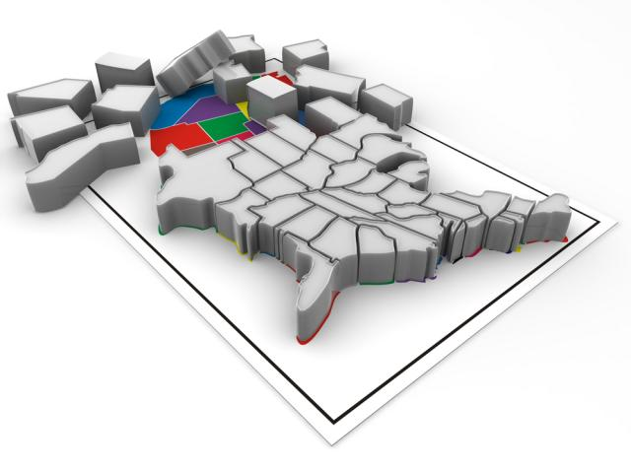
Report Contents and State Rankings

Slide 15
Senior Rankings
State | Rank
1 | Minnesota
2 | Hawaii
3 | New Hampshire
4 | Vermont
5 | Massachusetts
6 | Colorado
7 | Utah
8 | Oregon
9 | Delaware
10 | Wisconsin
11 | Maryland
12 | Connecticut
13 | Iowa
14 | Maine
15 | Washington
16 | Nebraska
17 | Kansas
18 | California
19 | North Dakota
20 | Michigan
21 | Virginia
22 | Pennsylvania
23 | Arizona
24 | New Jersey
25 | Idaho
State | Rank
26 | Rhode Island
27 | South Dakota
28 | Florida
29 | North Carolina
30 | Montana
31 | Ohio
32 | New York
33 | Wyoming
34 | South Carolina
35 | Illinois
36 | Alaska
37 | Indiana
38 | New Mexico
39 | Missouri
40 | Georgia
41 | Texas
42 | Nevada
43 | Tennessee
44 | Alabama
45 | West Virginia
46 | Arkansas
47 | Oklahoma
48 | Kentucky
49 | Louisiana
50 | Mississippi

Slide 16
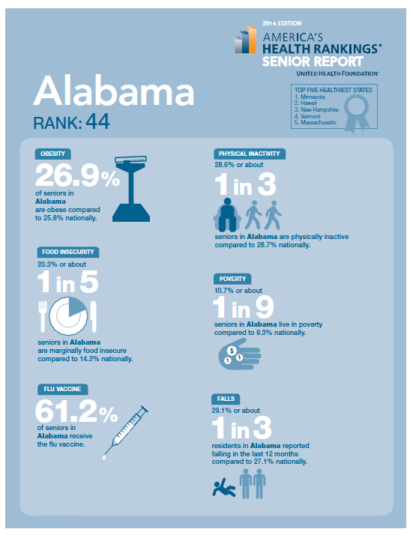
Infographics
Accent:
Obesity
Physical Inactivity
Food Insecurity
Poverty
Flu Vaccine
Falls
DRAFT

Slide 17
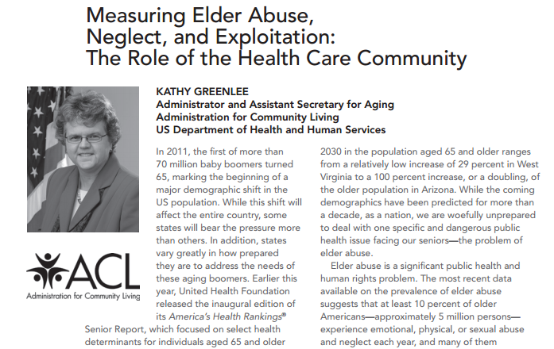
Commentary

Slide 18
What We Can Do

Slide 19
How to Put the Rankings to Use
Use America’s Health Rankings® Senior Report as a news hook to discuss strengths/challenges of your and other states and to highlight programs and activities geared toward seniors.
Use the Rankings to help people understand the importance of key interventions.
Help promote the America’s Health Rankings® “take action” library and your own websites and programs to translate knowledge into action.
Direct inquiries to resources on AmericasHealthRankings.org, which we are upgrading to be a responsive site in advance of the launch of the Senior Report. These include a PDF version of the Senior Report, state-specific infographics, custom-report tools and Spanish-language content.
Leverage successful models and advocate for change as individuals, a community and public health professionals.
United Health Foundation is committed to being a part of the solution, providing a full array of tools to help empower your missions to improve public health.

Slide 20




Thank You!
Contact Us:
Learn More:
Shelly Espinosa (general)
shelly_espinosa@uhg.com
952-936-1889
americashealthrankings.org
Scott Weier (media)
sweier@gpgdc.com
202-295-0170
/AmericasHealthRankings
@AHR_Rankings
Sarah Milder (data)
sarah@arundelstreet.com
651-222-6782
@DrReedTuckson
Tom Eckstein (data)
tom@arundelstreet.com
651-222-5257

